Slide 1
Trump Tweet Analysis
Twitter Queens

Slide 2
Expectations
We expect Trump’s tweets will be more negative overall.
We expect Tweets with Trump mentions will be half positive, half negative
We expect Trump Tweet Volume to be high
We expect Trump mentions from red (republican) states to be more positive
We expect Trump’s negative tweets to have higher engagement

Slide 3
APIs called/Datasets used
Twitter API : 'https://api.twitter.com/'
Standard Search API: https://api.twitter.com/1.1/search/tweets.json
GET statuses/user_timeline: https://api.twitter.com/1.1/statuses/user_timeline.json
GET users/show: https://api.twitter.com/1.1/users/show.json
2018 Trump Tweet Data Set: http://www.trumptwitterarchive.com/

Slide 4
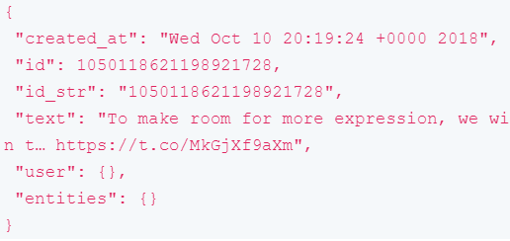
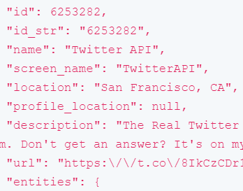
Example JSON Objects
Tweet Object
User Object

Slide 5
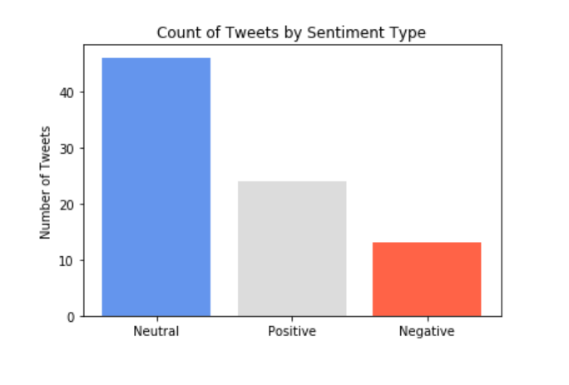
Sentiment Analysis on Trump Mentions
Library: TextBlob
https://textblob.readthedocs.io/en/dev/index.html
Python library for processing textual data
Provides simple API for common NLP tasks
Method: Sentiment
This function returns two properties:
Polarity: float which lies in the range of [-1,1] where 1 means positive statement and -1 means a negative statement.
Subjectivity: float which lies in the range of [0,1]. Subjective generally refers to personal opinion, emotion or judgment whereas objective refers to factual information.

Slide 6
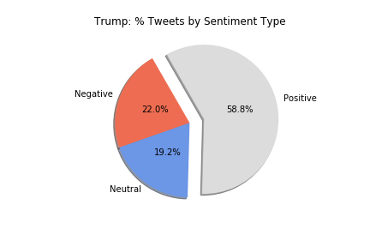
Sentiment of Trump’s Tweets
The majority of Trump’s tweets in 2018 (full year) and June 2019 had Positive sentiment, while 22% were negative.
Example Tweets:
Positive: “Five Most Wanted leaders of ISIS just captured!”
Negative: “We will be forced to close the Southern Border entirely if the Obstructionist Democrats do not give us the money to finish the Wall & also change the ridiculous immigration laws that our Country is saddled with. Hard to believe there was a Congress & President who would approve!”
Neutral: “I’ve done more damage to ISIS than all recent presidents....not even close!”

Slide 7
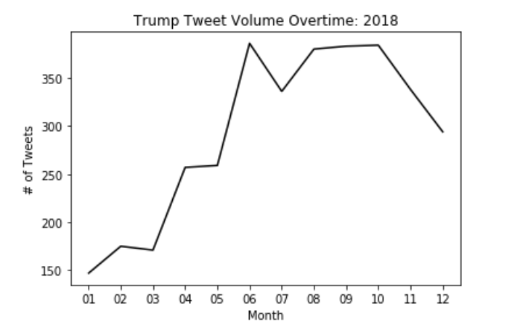
Trump’s Tweets Overtime
Tweet Volume:
Trump increased the amount he tweets during Q3 and Q4 of 2018. A few events that help explain the increase in June 2018:
US leaves UN Human Rights Council
Trump Places Tariff on Chinese Goods
Trump signs Executive Order ending family separation at the border for illegal immigrants
Mass shooting at a New Jersey art festival
Singapore Summit between North Korean leader Kim Jong-un and US President Donald Trump

Slide 8
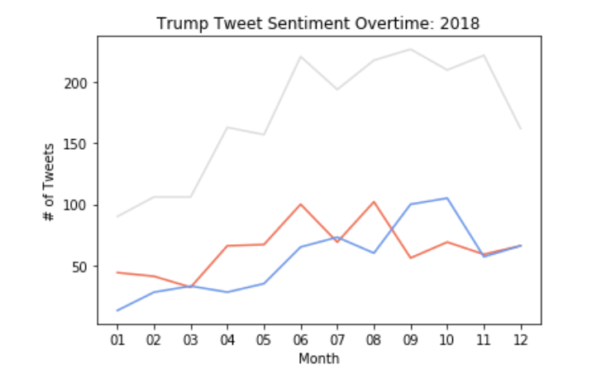
Sentiment of Trump’s Tweets Overtime
Sentiment: The increase in tweet volume was majorly on Positive sentiment tweets. His negative tweets started to increased in April, going above his 2018 average.
Avg Positive: 173 tweets per month
Avg Neutral: 55 tweets per month
Avg Negative: 63 tweets per month

Slide 9
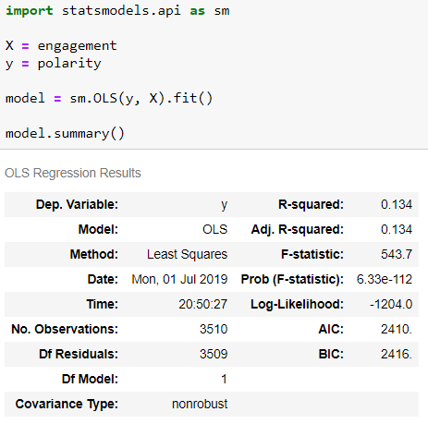
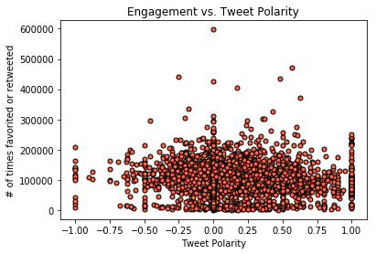
Trump’s Tweet Polarity vs. Engagement
(2018)

Slide 10
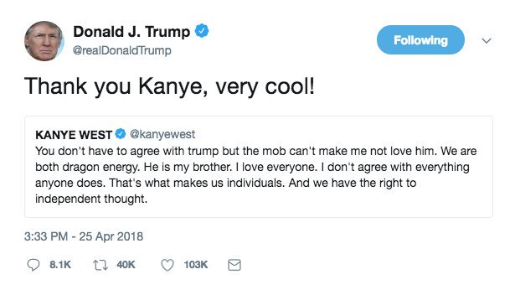
Trump’s Most Engaging Tweets:
In the past week:
“BORING!” - 6/26/2019
(First night of the Democratic presidential debate)
2018 Runner-up:
In 2018:
“Merry Christmas!”

Slide 11
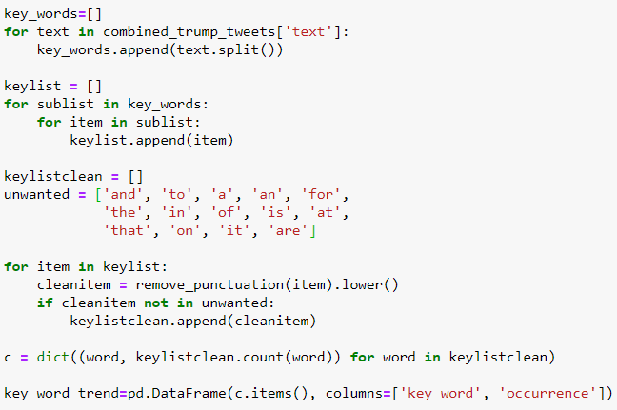
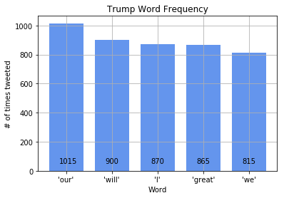
Trump’s Most Frequently Tweeted Words

Slide 12
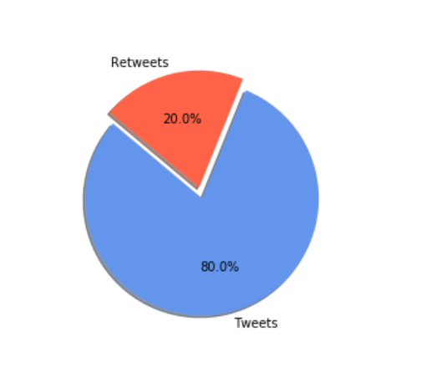
Trump’s Tweets / Retweets
Majority of Trump’s engagement on Twitter can be seen through tweets originating from his twitter handle.
Re-tweets are only at 20% of his twitter activity
The number of re-tweets were higher in 2018 when compared to 2019

Slide 13
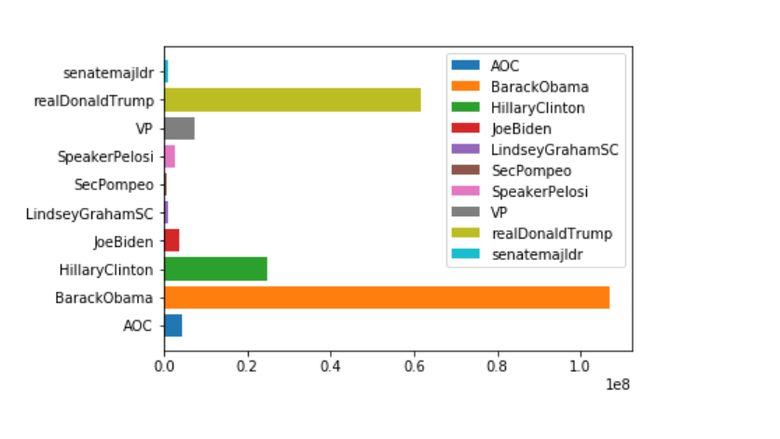
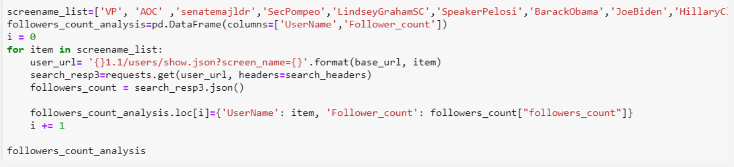
Politicians’ Popularity
API: GET users/show
Resource URL: https://api.twitter.com/1.1/users/show.json
Returns a variety of information about the user specified by the required ‘user_id’ or ‘screen_name’ parameter.

Slide 14
Conclusion
We expect Trump’s tweets will be more negative overall.
Most of his tweets were positive, followed by neutral.
We expect Tweets with Trump mentions will be half positive, half negative
Most Trump mentions were neutral, followed by positive
We expect Trump’s tweet volume to be high
Trump tweet volume is high
We expect Trump mentions from red (republican) states to be more positive
There was limited data on location associated with the tweets
We expect Trump’s negative tweets to have higher engagement
There is no correlation between tweet polarity and engagement

Slide 15
Thank you!

